Slide 1

Tennessee Tech ECE 1000 Final Projects
ECE 1000: Explorations in ECE
Electrical and Computer Engineering
Tennessee Tech University
March 18, 2024

Slide 2
ECE 1000 Final Project Information
Team Based Design Project Where Students:
Apply What They Have Learned During ECE 1000
Learn to Program a Raspberry Pi Pico and Interface With Sensors
Learn How to Relate Projects to Important Community Outreach and Innovation Themes
Learn How to Write a Project Report and Give a Project Demonstration
Learn How to Research Topics and Gather Information
Learn How to Create a GitHub Project Page and a Resume to Communicate Experience

Slide 3
Raspberry Pi Pico Microcontroller and Breakout Boards
The Raspberry Pi Pico is a Microcontroller (similar to the Arduino) which allows users to interact with and program logic to control different actuators and I/O peripherals (motors, switches, lights, screens, etc …)
The Raspberry Pi Pico WH is allows users to connect to Bluetooth devices and access Wi-Fi networks through the onboard Bluetooth and Wi-Fi chip
The normal Raspberry Pi Pico does not allow for access to Bluetooth and Wi-fi
To program the Raspberry Pi Pico, we use a variation called MicroPython,
Micropython allows for users to easily program microcontrollers with a Python style programming language instead of C++
The Breakout Breadboard Kit allows for users to easily connect different sensors and devices to the Raspberry Pi Pico and also provides buttons, LEDs, and a buzzer that students can use for their projects and for learning how to program!

Slide 4
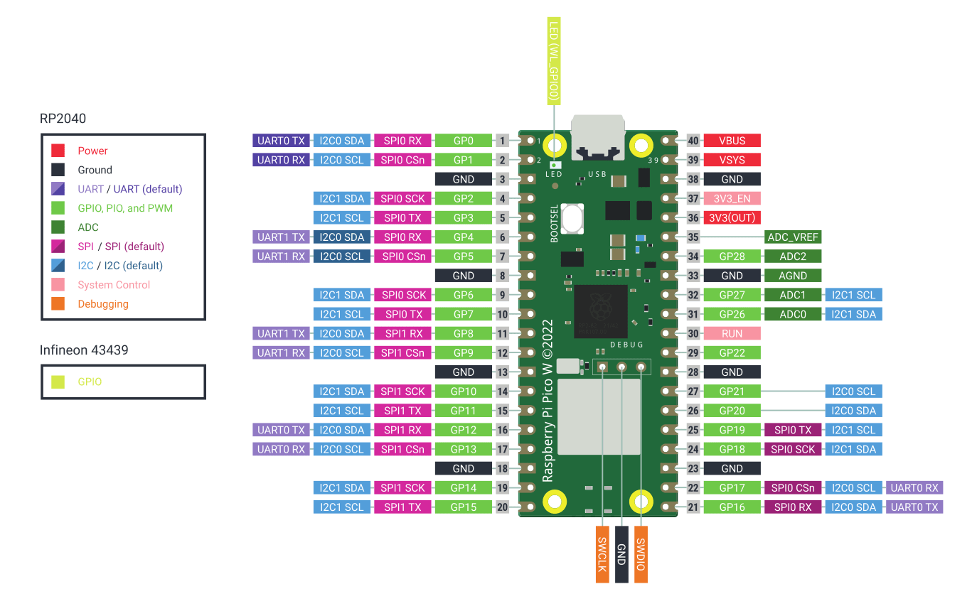
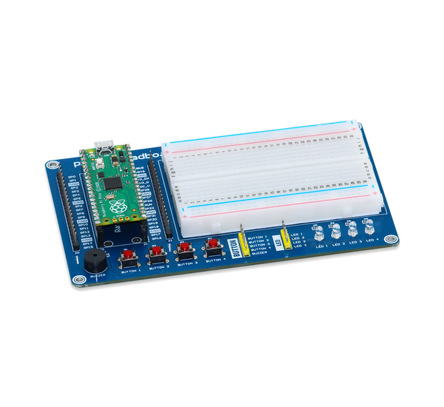
Raspberry Pi Pico Microcontroller and Breakout Boards

Slide 5
Getting Started With the Raspberry Pi Pico W-H
First, plug open up your Raspberry Pi Pico Board Kit and remove the anti-static wrapper
NOTE: When putting the board away, always place it back inside the anti-static wrapper!
Next, plug the micro-usb side of the cable into the Raspberry Pi Pico
Next, if you do not have the “Thonny” IDE installed, go to the following link and install it for your PC OS
Windows - Installer with 64-bit Python 3.10
Mac - Installer with Python 3.10
Link to Thonny Download - Thonny, Python IDE for beginners
Next, open the Thonny application once the installation is complete
NOTE: Hold down the “BOOTSEL” button on the Raspberry Pi Pico and plug it into your PC
If you don’t do this, the Raspberry Pi Pico won’t register correctly and you won’t be able to perform the next step!

Slide 6
Getting Started With the Raspberry Pi Pico W-H
Now, the Raspberry Pi Pico should appear as an “external drive” in your operating system (like a flash drive)
In the Thonny application, under the Run tab in the top of the program, click on Configure Interpreter
Then, Install or Update Micropython and the target value should list the device as RPI-RP2
Under Variant, select Raspberry Pi Pico W / Pico WH
Then, the Version should be auto filled to 1.22.2
Next, click Install and Micropython will be installed on your Raspberry Pi Pico WH!

Slide 7
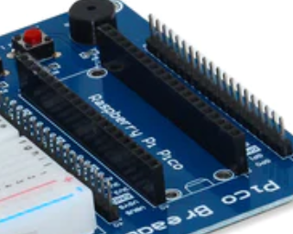
Getting Started With the Raspberry Pi Pico W-H
Next, close out of the Configure Interpreter and re-open it! In the field that says Which kind of interpreter should Thonny use for running your code select MicroPython (Raspberry Pi Pico)
In this Port field, select the text that says something similar to Board CDC @ COM# where # is some number
Your Raspberry Pi Pico WH is now ready to be programmed! If you haven’t already, you can place the RPI Pico into its spot on the breadboard printed circuit board (PCB)
NOTE: Make sure to line up the Raspberry Pi Pico where the usb port is above the usb port drawing on the circuit board, show below:

Slide 8
Programming the Raspberry Pi Pico WH – Blinking LED
Now that your Raspberry Pi Pico has been properly configured, lets do your first program!
This program will tell the Raspberry Pi Pico to “blink” the on-board LED. The on-board LED is a small, surface mount LED that is positioned next to the USB port.
Before we do this program, talk with your partner about what it means to blink an LED … what would you need to do if someone told YOU to blink and LED?

Slide 9
Programming the Raspberry Pi Pico WH – Blinking LED
When blinking an LED, we are turning an LED on … waiting some amount of time … turning the LED off … and waiting again for some amount of time
Computers are not Inherently smart … so when you program, you have to take your logic a step at a time!
When programming in Micropython, we can import libraries that have taken compilated concepts and created functions which allow us to easily interface with the Raspberry Pi Pico to make it do whatever we need it to do!
For this program, we will be using the machine and utime libraries, which will let us interact with the “Pins” and “Internal Circuits” of the Raspberry Pi Pico and also use the on-board clock to create timed actions
The import machine statement will tell the IDE that we want to use the machine library and the import utime statement will tell the IDE that we want to use the utime library.

Slide 10
Programming the Raspberry Pi Pico WH – Blinking LED
Next, we need to tell the IDE that we want to have an object turn on and off … but before we can do that, we need to tell the IDE what will be turning on and off!
On the Raspberry Pi Pico, the on-board LED is listed as “LED” and can be pointed to by the Micropython statement led = machine.Pin(“LED”, machine.PIN.OUT)
This will tell the Raspberry Pi Pico that whatever we will be doing next, will involve the LED that is on board
Next, how long do we want the Raspberry Pi Pico to blink the LED? For a second? Two seconds? … for ever?
We can chose to have the Raspberry Pi Pico blink this LED for as long as power is being supplied to the device by using what is called a While Loop, or a function that will execute the instructions inside of it as long as it stays in the loop … meaning if we don’t tell the IDE to leave the loop … we will continually blink the LED

Slide 11
Programming the Raspberry Pi Pico WH – Blinking LED
Finally, to actually blink the LED, we need to do what? How long do you want the time between off and on to be?
Before we run the code, in the top of the Thonny application, under File, click Save As and then click Raspberry Pi Pico and enter the name you want this program to be saved under … make sure to add .py at the end!
For example: blinking_led.py
Now, click the green play button in the Thonny IDE or under Run hit Run Current Script
This is a very simple code, but the process remains the same!
Call any libraries you want to use (did you find a cool library that will make things easier on you? Call it at the beginning and test it out!)
Declare what devices are hooked up to what pins on the Raspberry Pi Pico (if you have a buzzer on Pin #, then tell the IDE so it knows!)
Create a While Loop or another kind of loop where the IDE knows for how long to execute your code!
Tell the IDE what instructions you want to execute while in the loop! One instruction? Two? Three? Do they depend on certain conditions?

Slide 12
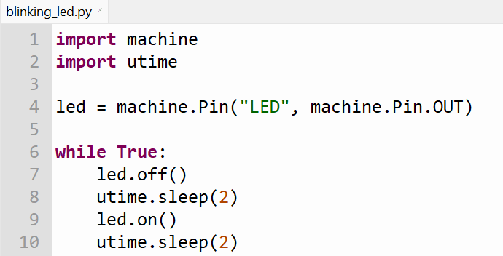
Programming the Raspberry Pi Pico WH – Blinking LED

Slide 13
Incorporating the Breakout Board With the Raspberry Pi Pico
Now that you have programmed the Raspberry Pi Pico, lets move to something a little more difficult … programming the microcontroller with the breakout board, buzzer, buttons, and LEDs!
This program will prompt a user to press a specific button, which will then turn on the buzzer at a certain tone and light up a specific LED on the breakout board. If you want, you can change the button number and LED number from what we will be doing to try different parts on the board.
First, as we did last time, we are going to import two libraries to help us make controlling the buzzer, buttons, and LEDs easier … the first is PicoBreadboard and the second is time (which is similar to utime)
The PicoBreadboard library is actually another Micropython script that was developed by the manufacturers of the breakout boards we will be using for the project. Calling this script will let us easily control the buzzer, buttons, and LEDs and tell the Raspberry Pi Pico which pins are plugged up to these devices.

Slide 14
Incorporating the Breakout Board With the Raspberry Pi Pico
The statement to import the PicoBreadboard script is: from PicoBreadboard import LED,Buzzer,Button
The statement to import the time library is: import time
Well, since we are using the PicoBreadboard script … we need to download it and upload it to the Pico!
Go to the following GitHub link, click on PicoBreadboard.py and then click the download button
GitHub - sbcshop/Raspberry-Pi-Pico-Breadboard-Kit: Raspberry Pi Pico Breadboard Kit is a multi-purpose Kit that consists of a “400 points half-size breadboard” on top, a Programmable Buzzer, 4 Programmable LEDs, 4 Push buttons, and dedicated 5V, 3v3, and GND pins at a single place.
Next, open the PicoBreadboard.py script in the Thonny IDE, click save as, click Raspberry Pi Pico, and then run the script.
Now, we successfully imported the needed libraries for our program! What do you think comes next in the process?

Slide 15
Incorporating the Breakout Board With the Raspberry Pi Pico
Now that the libraries are imported … we need to declare what devices we will be using and what pins they will be plugged into on the Raspberry Pi Pico. For this program, we want an LED to turn on once a button is pressed and for the buzzer to play a tone … so lets just choose LED 1 to turn on when Button 1 is pressed and for the buzzer to play a tone
First, lets tell the IDE to connect the LED to the GPIO 0 pin of the Raspberry Pi Pico … we do this using the following statement: LED1 = LED(0)
Next, lets tell the IDE to connect the first button to the GPIO 4 pin of the Raspberry Pi Pico with the following statement: BUTTON1 = BUTTON(4)
Finally, lets tell the IDE to connect the buzzer to the GPIO 8 pin of the Raspberry Pi Pico with the following statement: BUZZER = BUZZER(8)
Now, we have told the IDE how we are going to connect these devices to the Raspberry Pi Pico … so we actually have to connect everything correctly!

Slide 16
Incorporating the Breakout Board With the Raspberry Pi Pico
Using the jumper wires in your kit, connect the LED 1 pin to the GPIO 0 pin, the Button 1 pin to the GPIO 4 pin, and the buzzer pin to the GPIO 8 pin
Next, we need to program the IDE with the instructions that will actually make the buzzer and LED turn on once the button is pressed (up to this point, we have just told the IDE what devices are connected where!)
First, since we want this program to execute as long as we have power supplied … we are going to be using a while loop … so we will use the statement while True: or we could use while 1: these mean the same!
Next, the actual instructions and logic will be inside the while loop, which means that once you hit enter, it should indent! Indention in Python shows that the instructions following are only executing in that specific function
So … what logic do we want to use to make this happen? Take a few minutes to think about what will be needed to make the buzzer and LED come on once the button is pressed with your teammate

Slide 17
Incorporating the Breakout Board With the Raspberry Pi Pico
Let’s say that in addition to making the buzzer and LED turn on once the button is pressed, we also want to show the status of the button and LED to the user … Is the button pressed? Is the LED on?
When the button is pressed, we want the LED to turn on and for the buzzer to sound
When the button is released, we want the LED to turn off and for the buzzer to stop sounding
So, we have two conditions that we can execute using the two statements:
If BUTTON1.read() == 1:
else:
The first statement will execute the code beneath it if the button is pressed … 1 represents a logic ON
The second statement will execute the code beneath it if the button is released … else means any other time

Slide 18
Incorporating the Breakout Board With the Raspberry Pi Pico
Now, if we want to turn the LED on and the buzzer on … we just use the following two statements
LED1.on()
BUZZER.on()
Now, if we want to turn the LED and the buzzer off … we just use the following statements
LED1.off()
Buzzer.off()
In order to show the user the status of the button and LED, we can just use the following statements
print(“LED 1 On”)
print(“LED 1 Off”)
print(“Buzzer 1 On”)
print(“Buzzer 1 Off”)
Finally, sometimes when printing to the console, you want to delay the speed at which the statement is printed in order to make it easier to read what is being printed in the console
time.sleep(0.5)

Slide 19
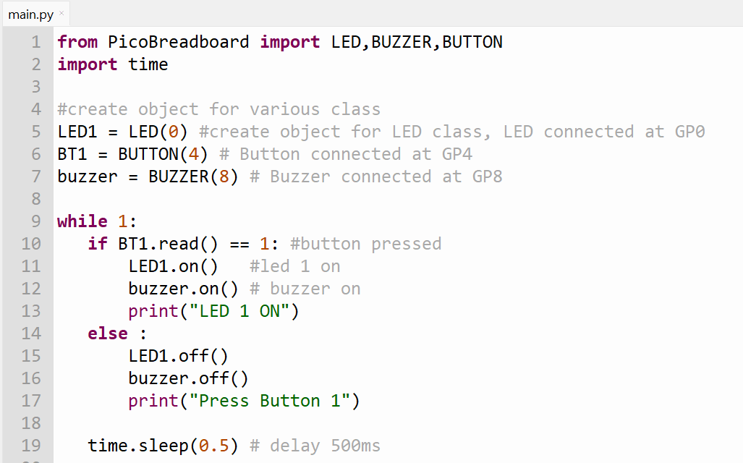
Incorporating the Breakout Board With the Raspberry Pi Pico

Slide 20
How to Relate Engineering Projects to Outreach and Innovation
National Academy of Engineering 14 Grand Challenges
Advanced Personalized Learning
Make Solar Energy Economical
Enhance Virtual Reality
Reverse-Engineer the Brain
Engineer Better Medicines
Advance Health Informatics
Restore and Improve Urban Infrastructure
Secure Cybersecurity
Provide Access to Clean Water
Provide Energy from Fusion
Prevent Nuclear Terror
Manage the Nitrogen Cycle
Develop Carbon Sequestration Methods
Engineer the Tools for Scientific Discovery
Institute of Electrical and Electronics Engineers (IEEE) Engineering Projects in Community Service
Access and Abilities
Environment
Education and Outreach
Human Services

Slide 21
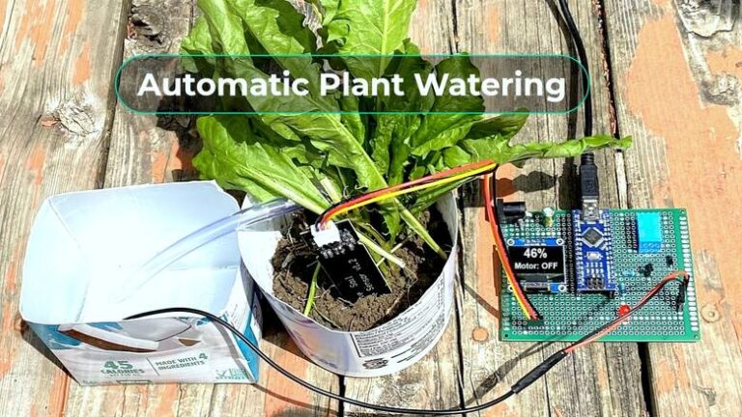
Possible Themes for ECE 1000 Final Project
Automatic Plant Watering System:
Components:
Raspberry Pi Pico
Soil Moisture Probe
Water Tank
Tubes
DC Motor Water Pump
etc…
Goals:
Measure the water level/moisture level of the soil
Tell the Raspberry Pi Pico to send water if needed
If not needed, continually measure the water level
Be able to override and send water upon user input

Slide 22
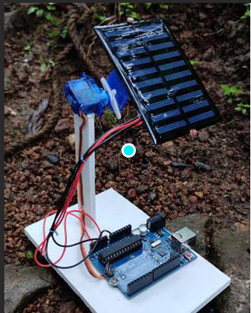
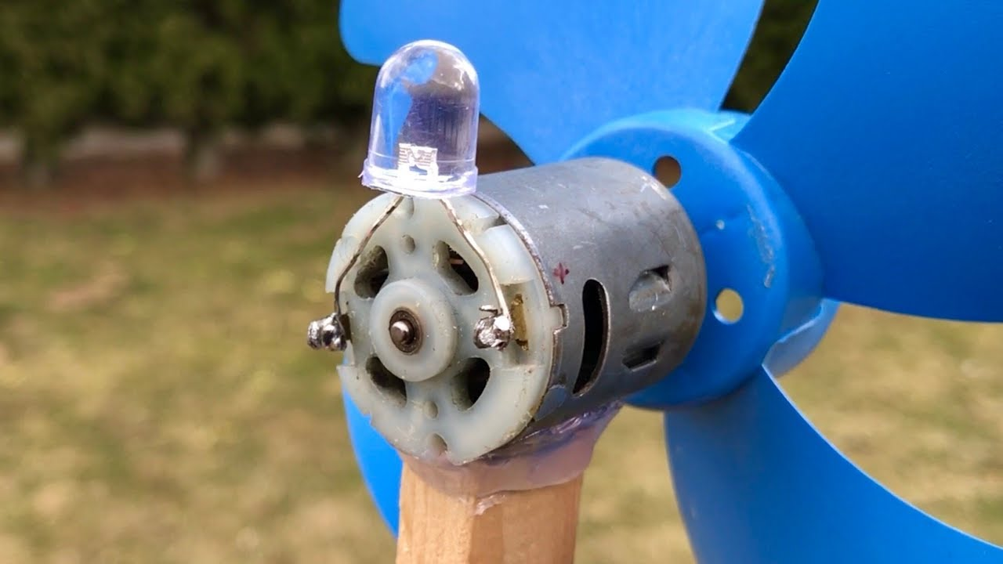
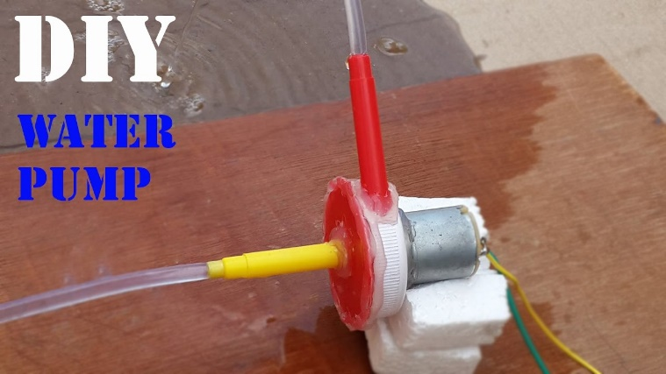
Possible Themes for ECE 1000 Final Project
Renewable Energy Generation System:
Components:
Raspberry Pi Pico
DC Motors
3D Printed/Built Wind Turbine
3D Printed/Built Water Wheel
Solar Panel
LEDs (think street lights!)
Goals:
Provide power to LEDs or other load of choice
Create windmill fans for the windmill
Create waterwheel spokes for waterwheel
Attach to DC Motors (spinning will generate voltage!)
Use Solar Panels to Power LEDs
Monitor the voltage applied and show it on a LCD screen

Slide 23
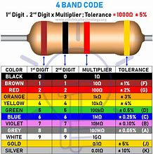
Possible Themes for ECE 1000 Final Project
Resistor Color Code Game:
Components:
Raspberry Pi Pico
Breakout Breadboard
Buttons
LCD Screen
Buzzer
RGB LEDs
Goals:
Create a Resistor Color Code Game/Quiz
This will be used to help students learn codes
Prompt the user with a resistance for a 4 band part
Ask the user to use the buttons to select the color
Show the color that the user entered for the band
Sound the buzzer with a song when the user is correct
Keep track of the points and show it on the screen

Slide 24
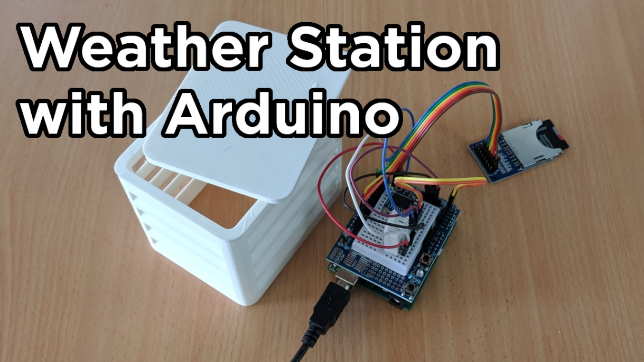
Possible Themes for ECE 1000 Final Project
Weather Station:
Components:
Raspberry Pi Pico
Temperature Sensor
Humidity Sensor
IR Sensor (Level Sensor)
LCD Screen
Smartphone (if time and interest)
3D Printed Case
Goals:
Create a Weather Station using the Pico and related sensors
Calculate the current temperature and humidity of an area
Calculate the water level using a rain gauge (IR sensor … level sensor)
Put the weather station in a weather-proof 3D printed box
If time, send the data from the weather station to a smartphone for remote viewing
If time, get location data from Wi-Fi and show location data on the

Slide 25
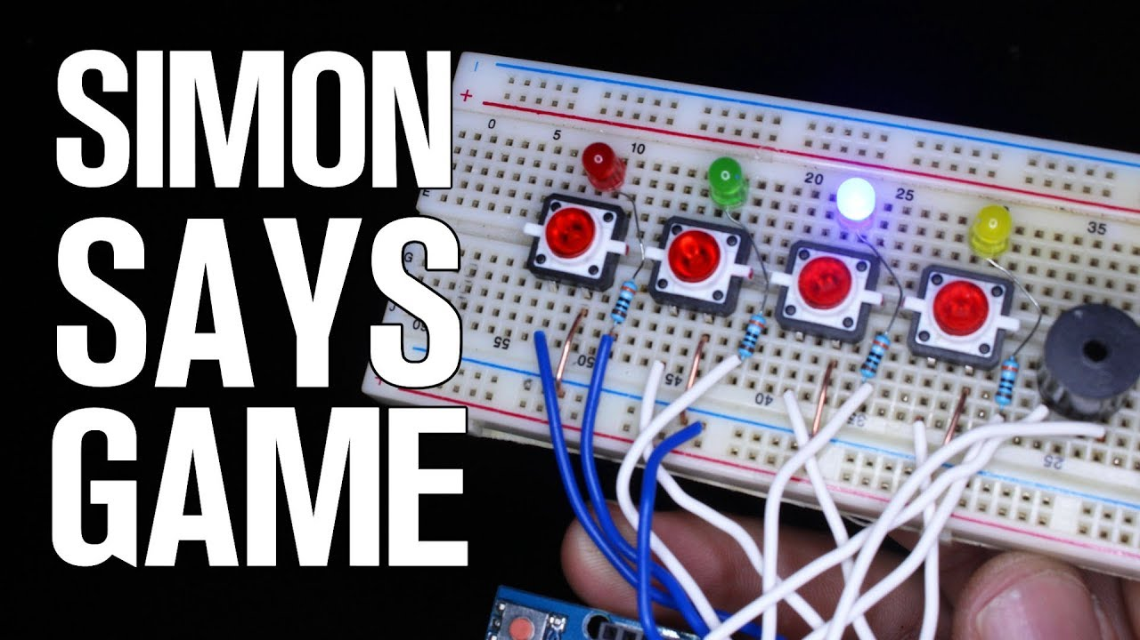
Possible Themes for ECE 1000 Final Project
Memorization Game:
Components:
Raspberry Pi Pico
Colored Buttons
RGB LEDs
Buttons
Buzzers
LCD Screen
Goals:
Create a memorization game for kids … input the pattern!
Use the Raspberry Pi Pico to make a pattern recognition game
Start with small patterns (Red, Red and Green, Red and Green and Blue, etc…)
Show the colors on the RGB LEDs
Prompt the user to choose the colors that appeared, in the correct order, by pushing buttons
Play a song when right
Play an error when wrong
Show points on an LCD screen

Slide 26
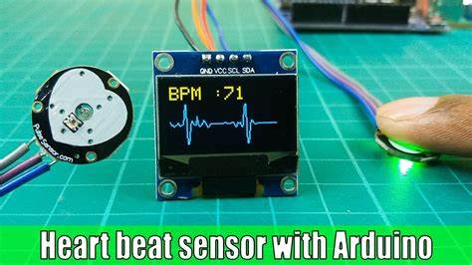
Possible Themes for ECE 1000 Final Project
Health Analytics and Advancing Health Informatics
Components:
Raspberry Pi Pico
Heartbeat Sensor
Temperature Sensor
3D Printed Case
LCD Screen
Smartphone (if time)
Goals:
Create a low cost heart beat monitor using a heart beat sensor
Display the heart beat signal on an LCD screen
Also display the number of beats per minute
Also display the body temperature using a temperature sensor
If time, show it on a smartphone

Slide 27
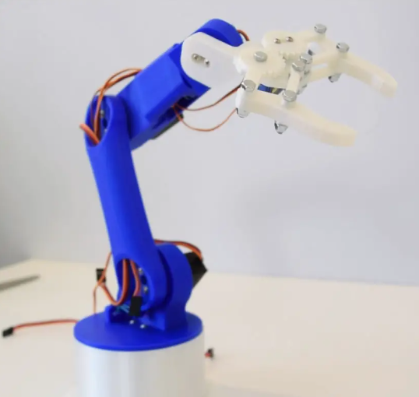
Possible Themes for ECE 1000 Final Project
Joystick Controlled Robot Arm (Servo Motors)
Components:
Raspberry Pi Pico
Servo Motors
Joystick (Wii Nunchuck)
LCD Screen
Goals:
Create a low cost robot arm using 3D printed chassis and motors
Use one, two, or more servo motors to create a controllable arm
Use the joystick (or Wii Nunchuck) to control the arm
Move the arm left and right, or left and right and up and down
If time, use a third servo motor to open and close a claw!
Display on a LCD screen the position of the motors …

Slide 28
What is Expected of You for This Project?
Complete a proper project report:
Introduction and Explain the motivation of your project (how does it fit into the 14 Grand Challenges and EPICS)
Describe the system and how it works … include a circuit schematic or block diagram of your parts (also any 3D prints we do)
Detail the total cost of the system and the results of the system (did it perform like you wanted it to? Did it meet the expectations?)
Tell readers why you were interested in this project … did it help you learn what concentration of ECE you would be interested in?
Create a Power Point Presentation Including a Demonstration Video(Possibly Posterboard)
Teams will give a power point presentation over their project (you can use a similar template to this one!)
The presentation will outline your report and also include a project demonstration video!
Create a GitHub Where the Team Can Upload Their Report, Presentation, Demo, and Files
This will be really nice to show your future employers for an internship, co-op, job, etc … they eat this kind of thing up!
Finally, create a Resume
While this may seem irrelevant, this will be great to put on your GitHub and bring to the in person presentation!

Slide 29
Final Thoughts
Have Fun! We don’t expect you to know how to code all of these projects by yourself, that’s why we are here!
Also, you have online resources you can research! (YouTube, Arduino Forums, Hackster.Io, Instructables, etc…)
If you use anything someone else created … You must cite it! Anything that is not your own must be cited
This also includes ChatGPT and other coding resoruces!
We want to give you a fun, meaningful project … use this time to find what you’re interested in!
If you have any other ideas, email JC and cc Dr. B and we will consider them!

Slide 30

Thank You!

